Slide 1
Regression Analysis
Regression Analysis in Practice
Nicoleta Serban, Ph.D.
Professor
Stewart School of Industrial and Systems Engineering
Emergency Department Healthcare Costs: Findings

Slide 2

About This Lesson

Slide 3
Access to Care: Intervention
Access to Primary Care
Availability
  Proxy for appointment wait times
  Takes values between 0 (low wait times) and 1 (high wait times)
Interpretation
An increase of 1% in lack of availability of primary care providers results in $1.00075 unit increase in ED cost PMPM, given all other predictors fixed
Policy Research Question
Does improvement in availability of primary care providers reduce the cost of ED care?

Slide 4
Findings: Access Intervention
newdata=dataAdult.no.out
index = which(newdata$Availability >= 0.5)
# Improve Availability to at most 0.5 congestion experienced by all communities
newdata$Availability[index] = 0.5
# Predict by changing Availability with all other predictors fixed
EDCost.predict = predict(reg.step.no.out, newdata, interval="prediction")[,1]
# Compare predicted to fitted for those communities with intervention
EDCost.diff.fitted = exp(fitted(reg.step.no.out)) - exp(EDCost.predict)
hist(EDCost.diff.fitted[index], xlab="Difference in Expected versus Predicted ED Cost",
main="Predicted vs. Fitted with Intervention", col="orange")
# Compare predicted to observed for those communities with intervention
EDCost.diff.observed = EDCost.pmpm[-909] - exp(EDCost.predict)
summary(EDCost.diff.observed[index])
hist(EDCost.diff.observed[index], xlab="Difference in Observed versus Predicted ED Cost",
main="Predicted vs. Observed with Intervention", col="red")

Slide 5
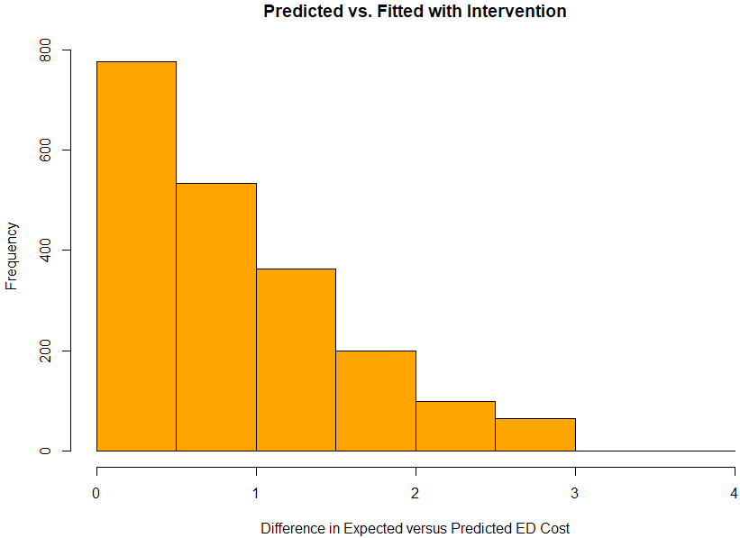
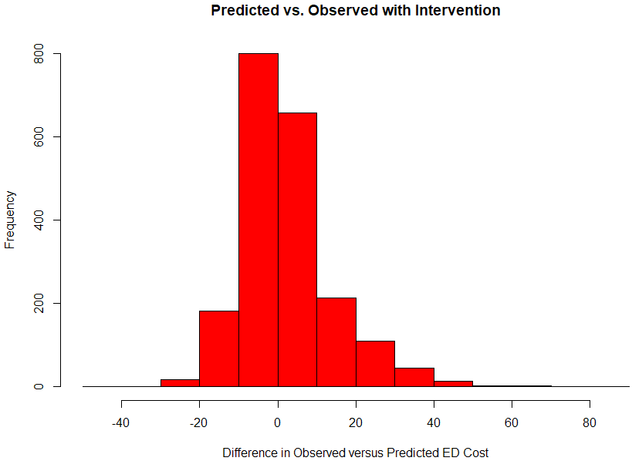
Findings: Access Intervention

Slide 6
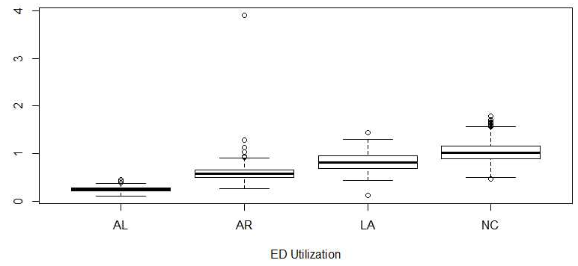
Findings: State Variations
Large variations in ED healthcare cost across the four states
  North Carolina leads and Alabama trails in ED care cost. Why?
    Medicaid programs vary by state
      Different health policies and reimbursements levels
    North Carolina leads and Alabama trails also in ED utilization PMPM
The correlation between ED cost and ED utilization is 0.899

Slide 7
Findings: Utilization
Utilization of physician office visits is positively associated with ED cost of care given the other predicting variables fixed in the model
  Correlation between utilization of physician office visits and utilization of ED is high (0.54)
    There may be communities with higher utilization of healthcare in general and thus higher ED costs
Utilization of inpatient care (hospitalizations) is positively associated with ED cost of care given the other predicting variables fixed in the model
  There is a very weak correlation between utilization of inpatient care and utilization of ED
  Further investigation is needed

Slide 8
Findings: Other Variables
Education is the only socioeconomic variable selected in the reduced model
  Other socioeconomic variables do not add additional explanatory power given the other predicting variables in the model
Availability of primary care providers is statistically significantly associated with ED cost of care
  Intervening to improve availability shows a reduction in the expected ED cost of care according to the fitted model
    Such analysis relies on causal inference
Whether living in urban or rural communities is not statistically significantly associated to ED cost of care given other predicting variables in the model

Slide 9

Summary

